Slide 1
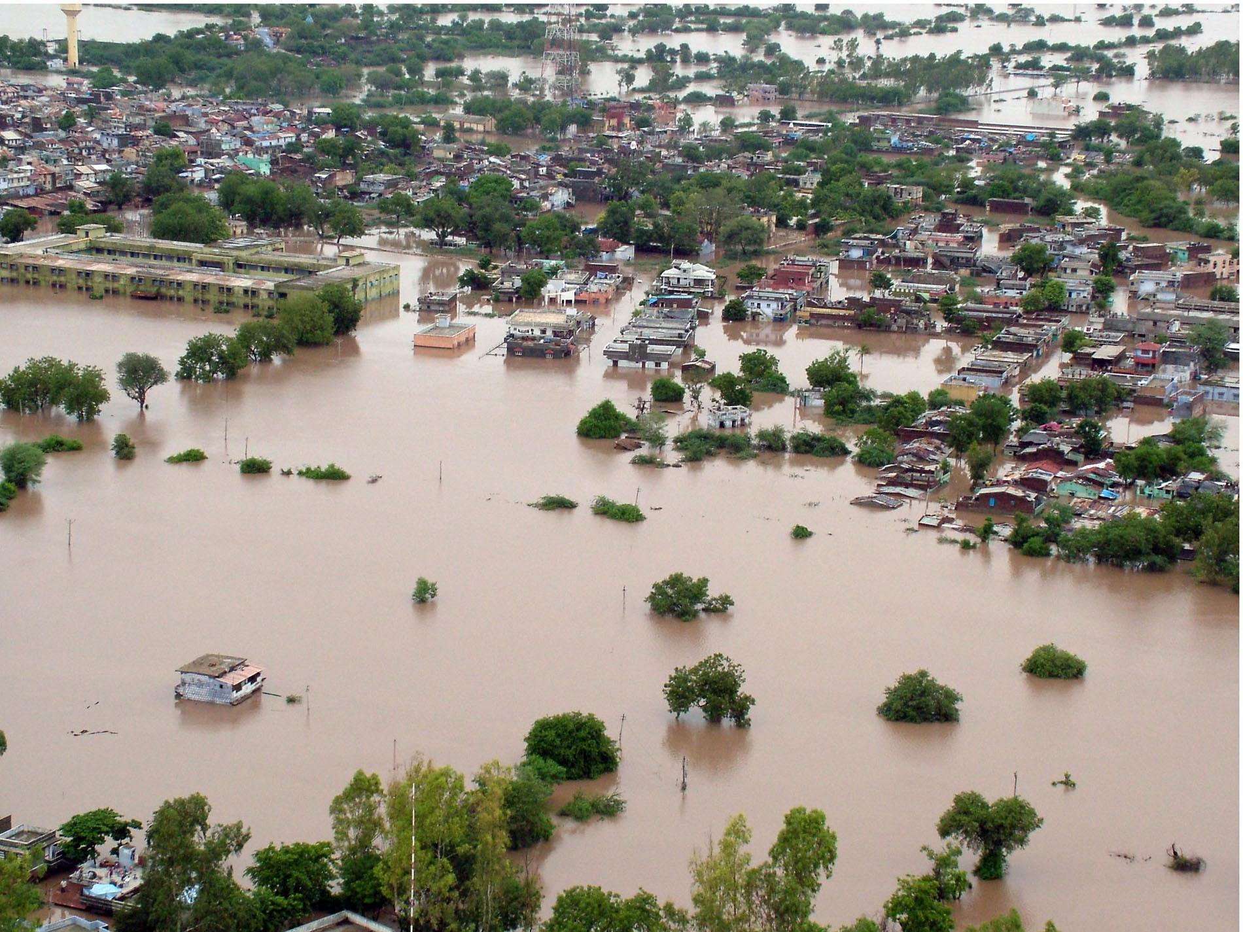
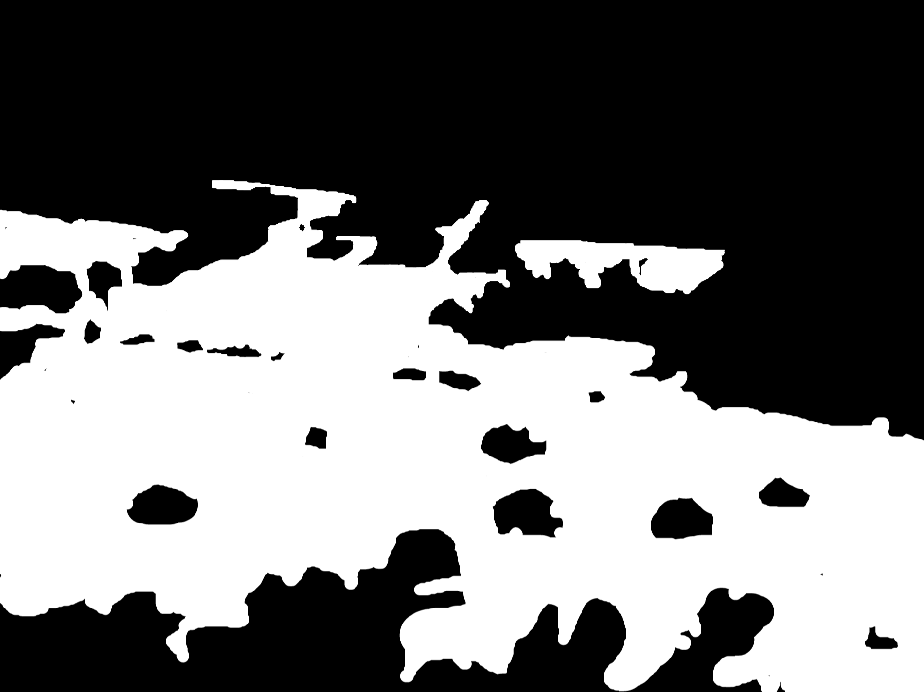
Flood Impact Detection on Roads Using U-Net
Shaoun Chandra Shill Fahim Ahmed ifty
23373005 23266007
Tuhin Ahmed Effat Jahan
23173004 24366047
GROUP - 06

Slide 2
Project Idea
Design a U-net model for the classification and segmentation of parts of road images in Bangladesh affected by flood. This would be useful for evaluating the effects of floods on road construction as a way of determining the extent of damage in areas that experience flood ravages during certain seasons of the year. Segment out flooded region of roads in Bangladesh using satellite images or from any aerial view.

Slide 3
Project Related Paper
U-Net: Convolutional Networks for Biomedical Image Segmentation. link - https://doi.org/10.48550/arXiv.1505.04597
Image Segmentation Methods for Flood Monitoring System. link - https://doi.org/10.3390/w12061825
Road Extraction by Deep Residual U-Net. link- https://arxiv.org/pdf/1711.10684
Satellite Image Segmentation for Building Detection using U-net. link - https://cs229.stanford.edu/proj2017/final-reports/5243715.pdf

Slide 4
Project Dataset
Flood Area Segmentation
Link : https://www.kaggle.com/datasets/faizalkarim/flood-area-segmentation

